Slide 1


Employee Retention (HR Analytics)
Group 3

Slide 2
Group Details
NAME E-Mail ID Mobile Number
Ms.Shweta Gangurde gangurdesweety203@gmail.com 9860583857
Mrs. Archana Mahesh Thok archanat051996@gmail.com 9764508667
Mr.Rakshak Bhat rakshakbhat2800@gmail.com 6006069808
Ms.Rituparna Pradhan rituparnapradhan548@gmail.com 9827683137
K.Padmanapan padmanaban0806@gmail.com 6374495527
Miss. Dhruti Dharmeshwary dhrutidharmeshwary1999@gmail.com 6370991861
Mr. Faiyaz Nabilal Kalburgi Faiyaz.kalburgi05@gmail.com 8767061225

Slide 3
PROJECT SUMMARY
Project Title - Employee Retention Project
Objectives-
Human Resources (HR) analysis on a data analyst typically involves an in-depth evaluation of various aspects related to the performance, contribution, and impact of data analysts within an organization.
This analysis aims to derive insights into their efficiency, productivity, skill sets, and overall value they bring to the company
Scope-
Data Collection and Analysis
Predictive Modeling
Designing Retention Strategies
Employee Feedback and Engagement
Managerial Training and Support
Timeline-
The timeline for ERP project is scheduled from 16\01\2024 to 9\02\2024

Slide 4
Project Overview
In this project, we have used different types of analytical tools like Excel, Tableau, Power BI, SQL
We have created different dashboards on Lead and Opportunity Tables
Also, we have described various types of Key Performance Indicators (KPIs)

Slide 5
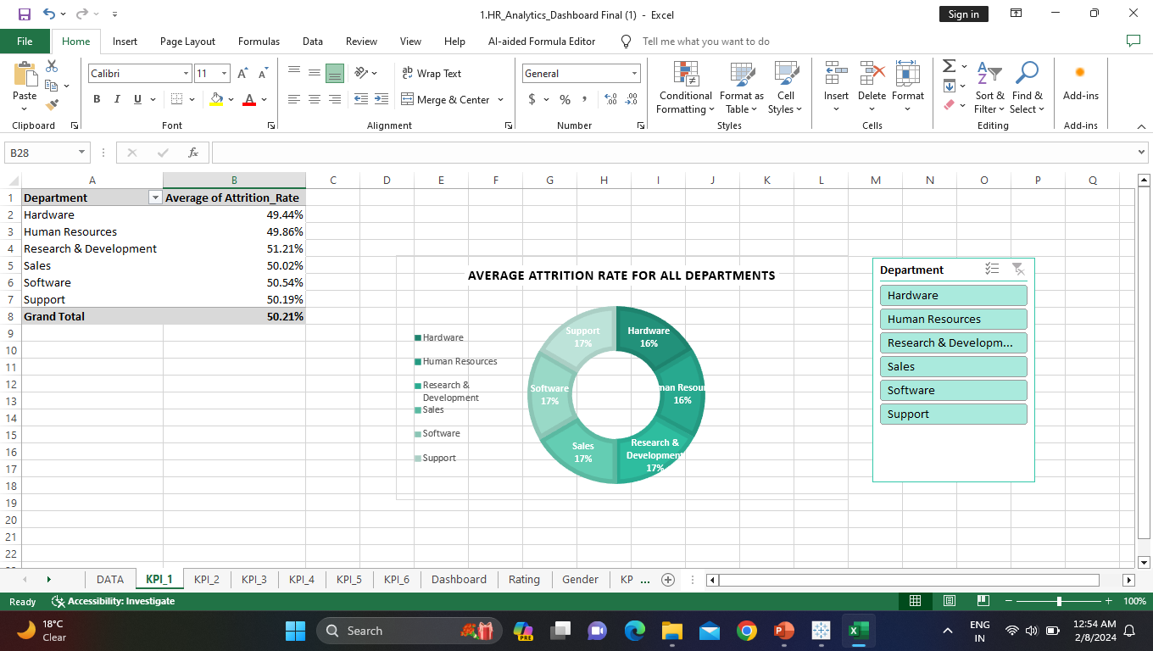
From Average Attrition rate for all Departments
We got-
>Highest attrition is on the research & development (51.21%)
>lowest attrition is on the Hardware (49.44%)

Slide 6
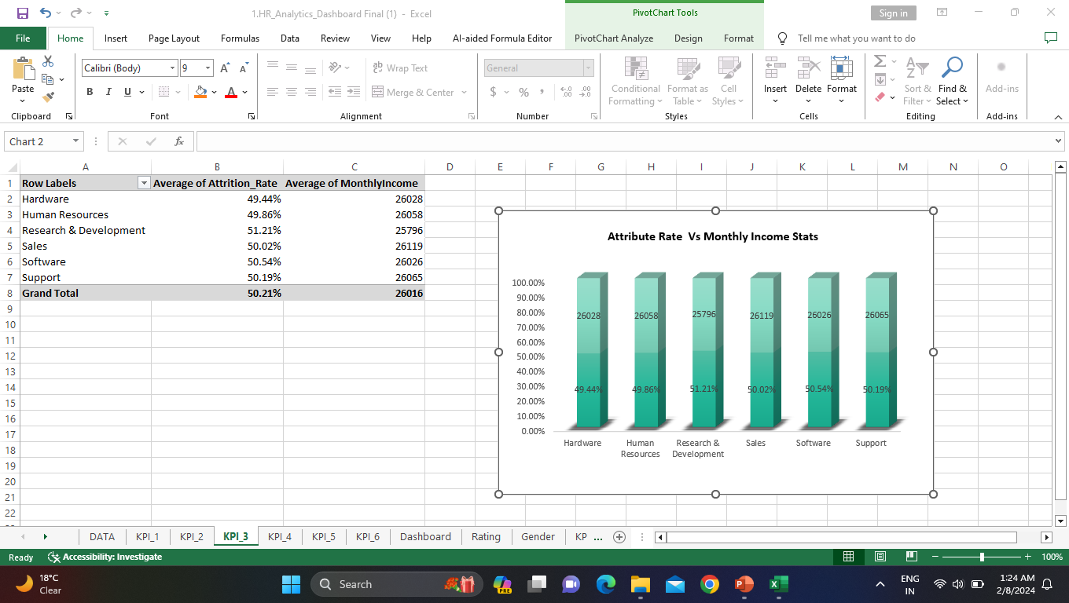
Attrition rate Vs montly income stats
We got –
Based on our analysis and visualization, it is evident that the Hardware Department has the lowest attrition rate of 49.44%, with an average monthly income of Rs. 26,091.20. On the other hand, the Research and Development Department has the highest attrition rate of 51.21%, with an average monthly income of Rs. 26,007.08

Slide 7
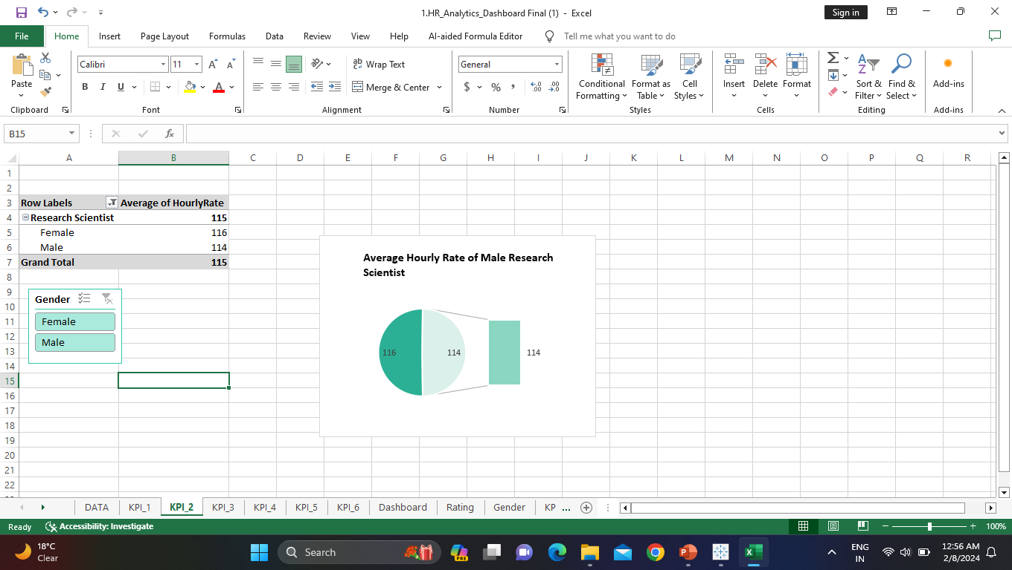
From Average Hourly rate of Research Scientist
We got -
>Average Hourly rate of Male Research Scientist is 114.4

Slide 8
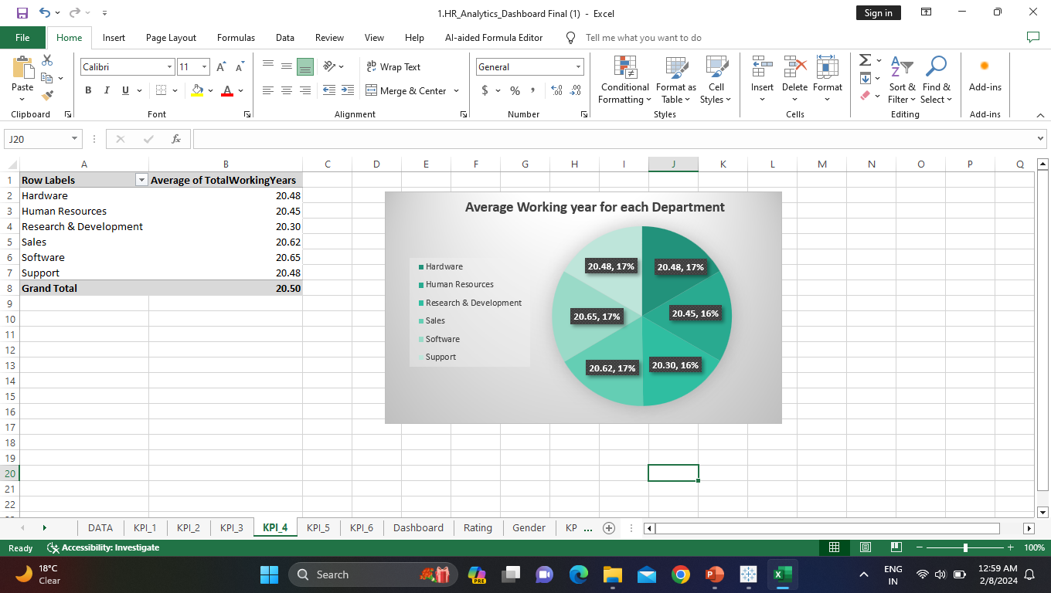
From Average working years for each Department
Avg. working years show how many year employees work on given department.
We got –
> Highest Avg. working years is on “Software” department (20.65)
> Lowest Avg. working years is on “Research & Development” department (20.30)

Slide 9
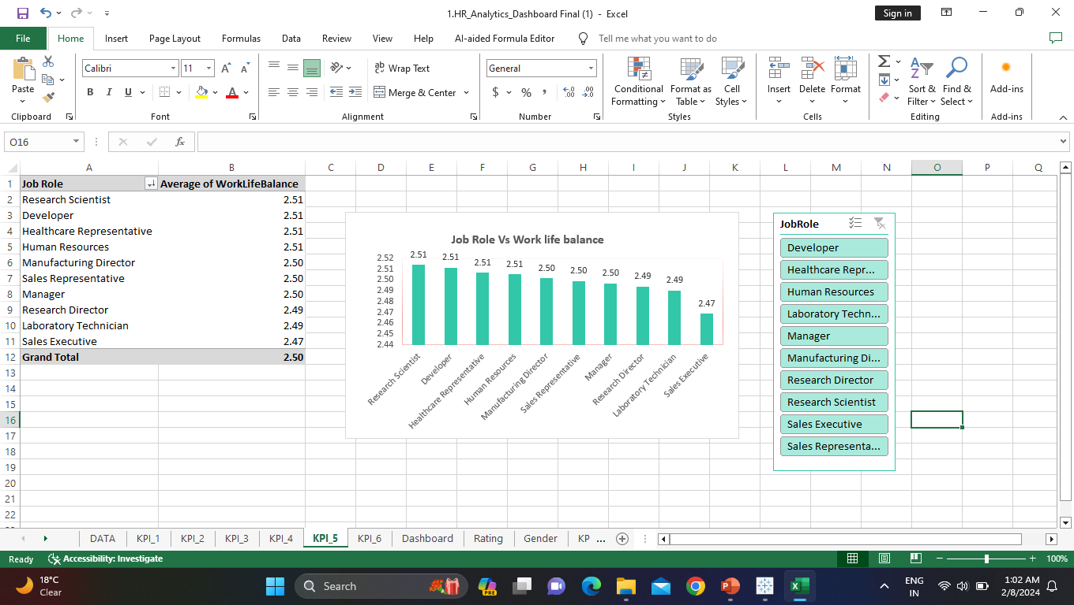
From Job Role Vs Work life balance
Work life balance show satisfaction of employees with our work . if employees give low rating it mean they not satisfy with our work.
We got –
>More number of employee give 1 work life balance.

Slide 10
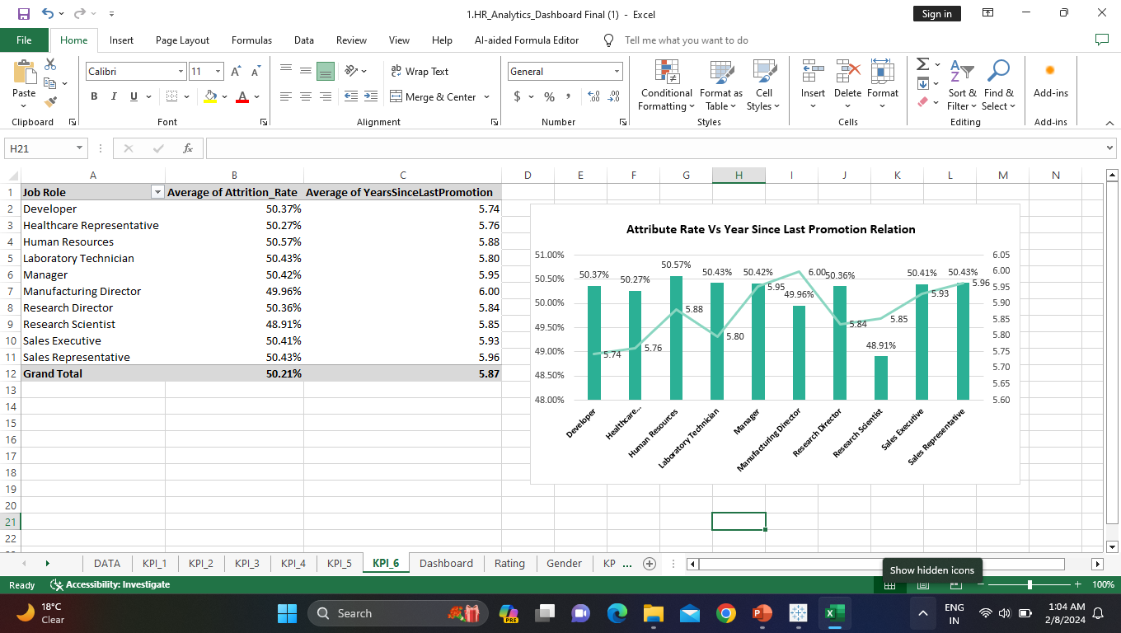
From Attrition rate Vs Year since last promotion relation
If people leave company in few year this show employees not satisfied with our work.
We got –
>In the last 1 to 25 years Attrition rate is around 50%
>highest attrition 51.21% on last 30 year
>lowest attrition 49.44%% on last 36 year

Slide 11
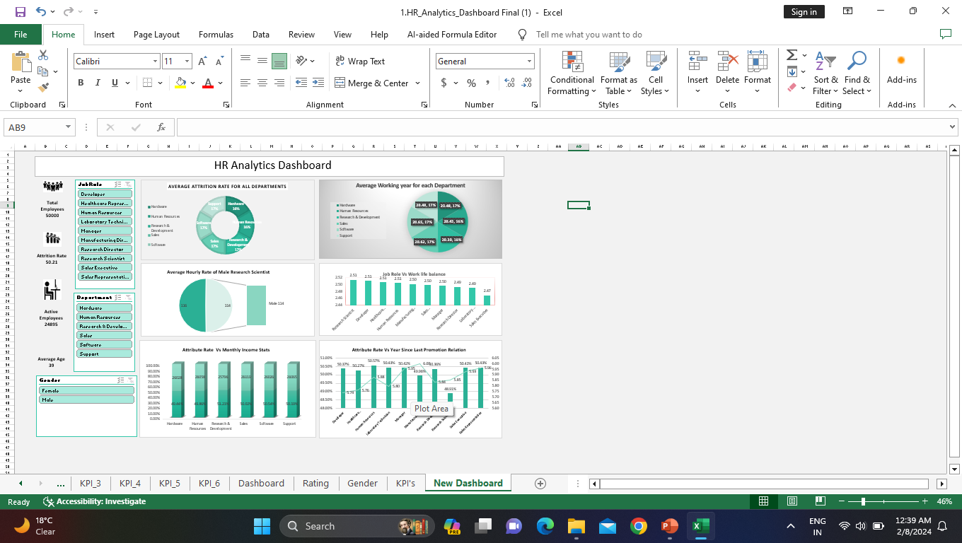
Excel dashboard

Slide 12
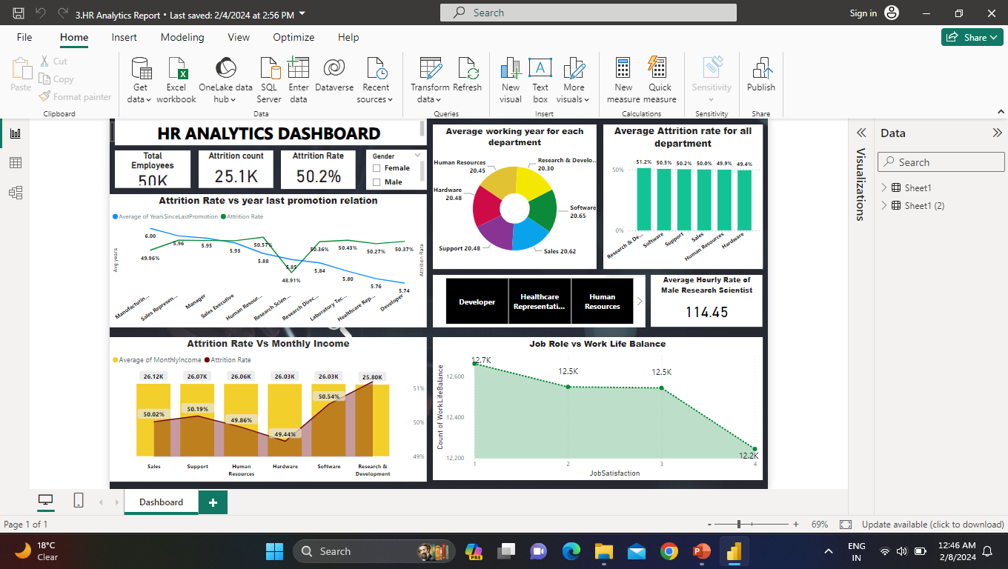
Power BI Dashboard

Slide 13
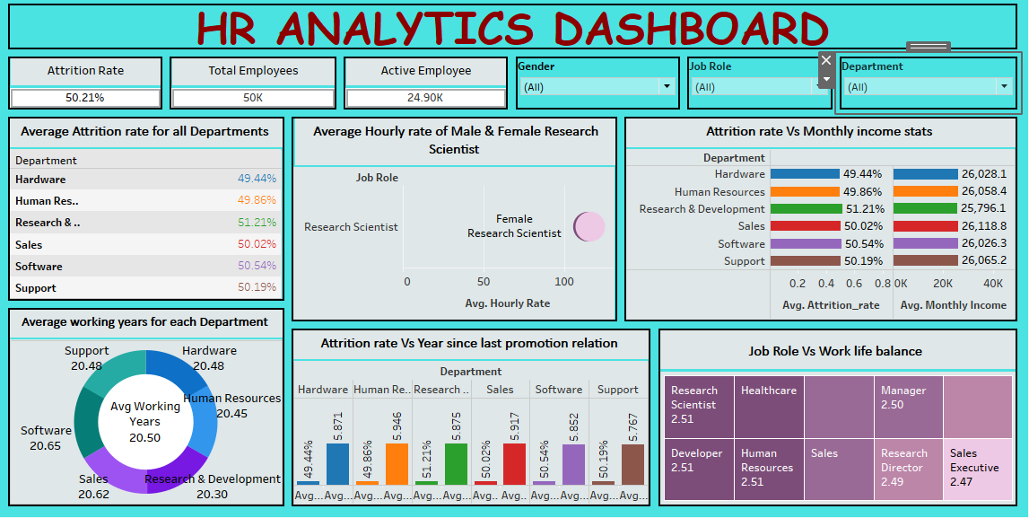
Tableau Dashboard

Slide 14
Conclusion
company need to improve working condition of research & development department because its attrition rate is high and Avg. working years is low in all department, that show employees are not satisfied here .
Average Hourly rate of Male Research Scientist is higher then female, it mean work load is higher on the male employee.
most of employees in Healthcare representative, Manufacturing Director and sales executive give 2 work life balance . This show employees not satisfied with their salary . company need to improve their salary .

Slide 15
THANK YOU

